Slide 1
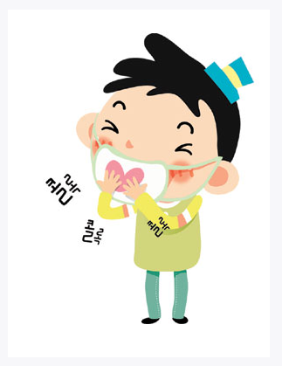
Chronic Cough
(GERD를 중심으로)
강 성 주

Slide 2
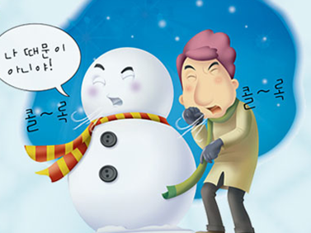
Classification of Cough
Acute cough : < 3 weeks
Subacute cough : 3-8 weeks
Chronic cough : > 8 weeks

Slide 3
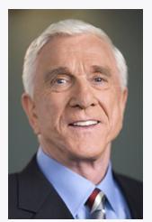
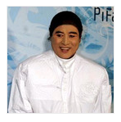
Common causes of Cough (1)
Infection
  Acute infections
    Tracheobronchitis
    Bronchopneumonia
    Viral pneumonia
    Exacerbation of COPD bronchitis
    Pertussis
  Chronic infections
    Bronchiectasis
    Tuberculosis (mild fever, wt loss)

Slide 4
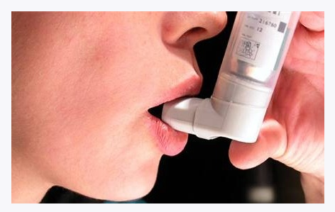
Common causes of Cough (2)
Airway disease
  Asthma
  Chronic bronchitis
  Chronic postnasal drip (UACS)
Parenchymal diseases
  Chronic interstitial lung fibrosis
  Emphysema
  Sarcoidosis
Tumors
  Bronchogenic carcinoma
  Alveolar cell carcinoma
  Benign airway tumors
  Mediastinal tumors

Slide 5
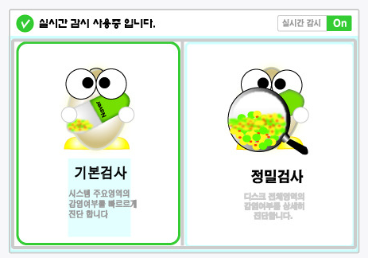
Common causes of Cough (3)
Foreign bodies
Middle ear pathology
Cardiovascular disease
  Left ventricular failure
  Pulmonary infarction
  Aortic aneursymm (thoracic)
Other diseases
  Reflux esophagitis
  Recurrent aspiration
  Endobronchial sutures
Drugs
  ACE inhibitors

Slide 6
Cx. from excessive cough (1)
Respiratory
  Pneumothorax
  Spontaneous emphysema
  Pneumomediastinum
  Pneumoperitoneum
  Laryngeal damage
Cardiovascular
  Cardiac dysrhythmias
  Loss of consciousness
  Subconjunctival hemorrhage

Slide 7
Cx. from excessive cough (2)
CNS
  Syncope
  Headache
  Cerebral air embolism
Musculoskeletal
  Rib Fx.
  Intercostal muscle pain
  Rupture of rectus abdominis muscle
  Increase in serum CPK
  Cervical disc prolapse

Slide 8
Cx. from excessive cough (3)
Gastrointestinal
  Esophageal perforation
Other
  Social embarrassment
  Depression
  Urinary incontinence
  Disruption of surgical wounds
  Petechiae
  Purpura

Slide 9
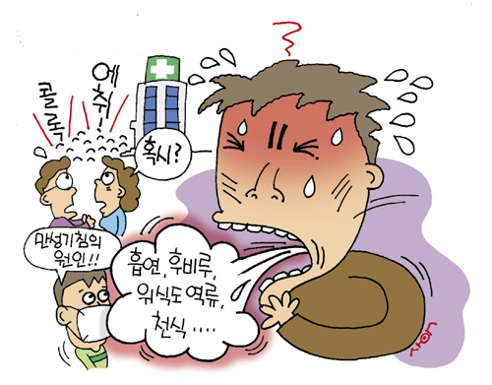
우리나라에서 만성기침의 원인
N=105
UACS 39.3%
Asthma 32.2%
GERD 14.1%
Chronic bronchitis 5.0%
Others 4.1%
  Drug-induced
  Bronchiolitis
  Endobronchial tuberculosis
  Lung cancer
천식 및 알레르기 학회지 1998

Slide 10
Chronic Cough
A cause of cough is suggested
History, Examination Chest X-ray
SmokingACE-I
Discontinue
Investigate and Treat
Upper airway cough syndrome (UACS)
Asthma
Non-asthmatic eosinophilic bronchitis (NAEB)
Gastroesophageal Reflux disease (GERD)
Further Investigations to consider
  . 24h esophageal pH monitoring
  . Endoscopic or videofluoroscopic swallow
  . Barium esophagogram . Sinus imaging
  . HRCT . Bronchoscopy . Echocardiogram
  . Environmental Assessment . Other rare causes

Slide 11
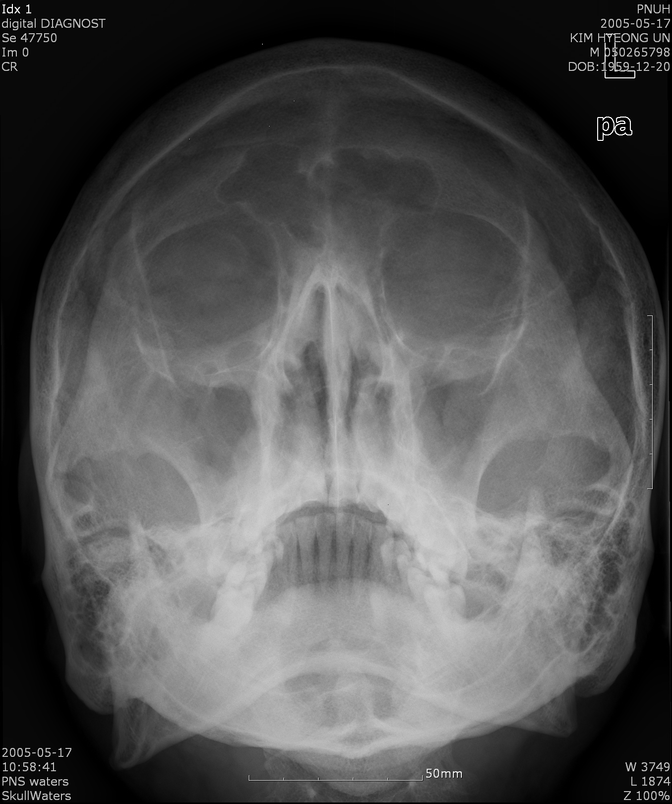
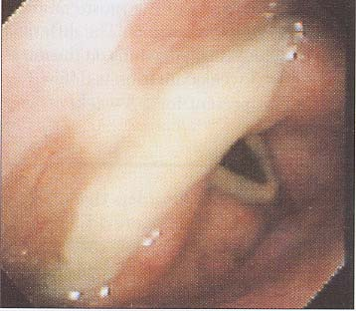
UACS
성인에서 가장 흔한 원인
Rhino-sinusitis
“Silent” PNDS

Slide 12
Causes of UACS
Vasomotor rhinitis
Non allergenic irritant
Drug-induced
Postinfectious rhinitis
Allergic rhinitis
Perennial nonallergic rhinitis
Sinusitis
%

Slide 13
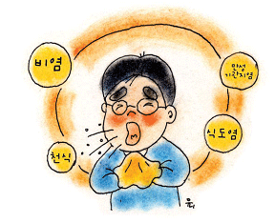
Asthma
Pathologic GERD in 70-80% of asthma patients
  Gastroenterology 1990;99

Slide 14
Nonasthmatic eosinophilic bronchitis (NAEB)
no objective evidence of variable
airflow obstruction,
normal airway hyperresponsiveness.
Sputum eosinophilia >3%

Slide 15
Corticosteroid Responsive
Cough Syndromes
Diagnosis | PEF variability | Bronchial hyperresponsivenes | Sputum eosinophilia
Classical asthma CVA NAEB | Yes No No | Yes Yes No | Yes Yes Yes

Slide 16
Post infectious cough
Viral or virus like infection
  Mycoplasma, Chlamydophila, Bordetella pertussis
Cough lasts no > 8 weeks
Normal chest radiograph
Post viral airway inflammation
Bronchial hyper-responsiveness
Impaired mucociliary clearance

Slide 17
ACEi
3-20%
ACE inhibitor should be discontinued regardless of the temporal relationship.
Dx is confirmed by resolution of cough usually 1-4 wks (up to 3-6months)
Repeated trial of ACE inhibitor may be attempted
Dose reduction : not helpful
ARBs or another drug class

Slide 18
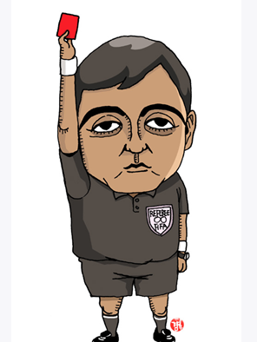
Indications for referral
Hemoptysis
  Malignancy, TB, PTE, CHF, MS
Weight loss, night sweats
  Malignancy, TB, AIDS
Purulent sputum
  pneumonia, TB
Immunosuppression
  PCP, TB and others

Slide 19
Anti - tussives
기침 구심신경에 작용하는 약
  Levodropropizine (레보투스시럽, 현대)
  lidocaine
  bupivacaine
기침 중추에 작용하는 약제
  Codeine (주로 pheniramine 등과 복합제)
  morphine
  dextromethorphan (러미러정, 로슈)
기침 원심신경에 작용하는 약제
  ipratropium bromide (아트로벤트)

Slide 20
Codeine
Dextromethorphan
Used cautiously in patients with reduced hepatic function
Used without modification in patients with renal failure
Drowsiness, nausea, vomiting, constipation
Synthetic derivative of morphine
No analgesic or sedative properties
As effective as codeine
Dizziness, nausea, vomiting, headache
Degradation in the liver

Slide 21
Normal CXR. No irritants.
Non smoker. No ACEi
UACS (PND) 배제
  항히스타민제에 호전 없고
호산구성 기관지염 배제
  객담도말검사 혹은 전신 혹은 흡입 스테로이드에 호전 없고
천식 배제
  Metacholline challenge test 혹은 천식치료제(steroid)에 반응 없으면
상기 증상 및 질환이 배제 가능하면 만성 기침환자에서 GERD를 고려…

Slide 22
Basic Information
Genval Workshop
Montreal Meeting
In Genval, Belgium
2-day workshop in Oct. 1997
35 medical doctors from 16 countries
  Primary care physicians
  Specialist gastroenterologists
  Health economists
  Surgeons
J. Dent et al. Gut. 1999 Apr; 44 Suppl 2:S1-16
In Montreal, Canada
  “Montreal” is in the title because the results of the study were first presented at the World Congress of Gastroenterology in Montreal 2005.
44 experts from 18 countries
  5 experts : through 4 voting, finally 51 statements developing
  The rest : only voting
Vakil et al. Am J Gastroenterol
2006; 101:1900-1920

Slide 23
Objectives
Genval Workshop
Montreal Meeting
To develop recommendations on the management of the full spectrum of reflux disease, including endoscopy negative patients.
  The workshop emphasized on matters relevant to practical patient management in both primary and specialist care.
  Childhood reflux disease, extra-oesophageal manifestations and refractory disease were not considered.
To develop a consensus definition and classification that would be useful for patients, physicians, and regulatory agencies.
  To develop rigorous methodology of GERD that could be used clinically by primary care physicians and that embraces the needs of physicians, patients, researchers, and regulatory bodies from different parts of the world
  GERD was subclassified into esophageal and extraesophageal syndromes

Slide 24
GERD Definition
Genval Workshop
Montreal Meeting
“Gastro-oesophageal reflux disease” should be used to include all individuals who are exposed to the risk of physical complications from gastro-oesophageal relux, or who experience clinically significant impairment of health related well being (quality of life) due to reflux related symptoms, after adequate reassurance of the benign nature of their symptoms
GERD (Gastro-esophageal reflux disease) is a condition which develops when the reflux of stomach contents causes “troublesome” symptoms and/or complications
  The word “Troublesome” satisfactorily describes the negative aspects of the symptoms from a patients’s standpoint

Slide 25
New Definition of GERD
GERD is a condition which develops when the reflux of stomach contents causes troublesome symptoms or complications
new definition include a patient-centered approach that is independent of endoscopic findings, subclassification of the disease into discrete syndromes, and the recognition of laryngitis, cough, asthma, and dental erosions as possible GERD syndromes.
Global Evidence-Based Consensus in Montreal
Vakil et al. Am J Gastroenterol 2006;101:1900-1920

Slide 26
Epidemiology of GERD
Sweden
25% (1998)
Finland
9% (1995)
Canada
13%(1999)
England
28.7% (2000)
Korea
3% (1994)
France
27% (1988)
United state
19.8%(1997)
32.6% (1993)
China
9% (2000)
Taiwan
5% (1997)
Italy
21% (1999)
Hong Kong
5% (1997)
Singapore
1.6% (1998)
New Zealand
30% (2000)

Slide 27
The prevalence of upper GI disorder
Peptic disease Stomach cancer GERD Functional
dyspepsia

Slide 28
Mechanism of GERD
Impaired esophageal Clearance
  impaired peristalsis
  low amplitude contractions
Incompetent Lower esophageal Sphincter (LES)
  inappropriate relaxation
  abnormally low LES pressure
Delayed Gastric Emptying
Duodenal-Gastric Reflux
Notes:
28

Slide 29
Dx of GERD with Cough
Definite Dx of cough due to GERD : cough nearly or complete disappear with antireflux therapy
24-hr esophageal pH-monitoring test : most sensitive and specific -> Limited
The degree of reflux dose not directly correlate with the severity of cough
Nonacid GERD : Barium esophagraphy
  Normal esophagography : do not rule out GERD

Slide 30
Tx of GERD
1) dietary and life style modification
2) acid suppression therapy : PPI
3) addition of prokinetic(한의학?) therapy
If medical therapy failed -> objective investigation of GERD
Antireflux diet
  no >45g of fat in 24h,
  no coffee, tea, soda, chocolates, mints, citrus products,
  alcohol, smoking, vigorous exercise, tomato, onion

Slide 31
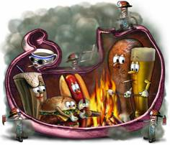
Gastroesophageal reflux disease
Typical reflux symptoms
Heartburn
Acid regurgitation

Slide 32
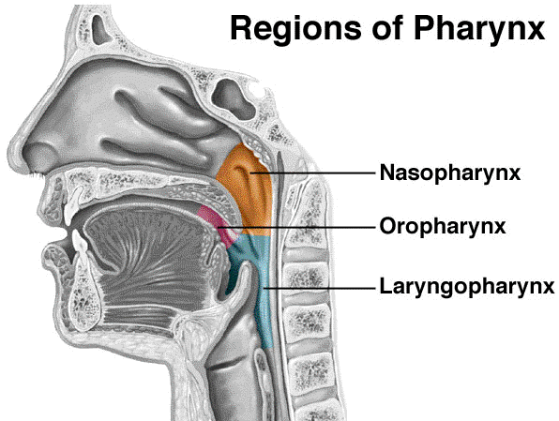
Damage to only esophagus ?

Slide 33
Esophageal Syndromes
Extraesophageal Syndromes
Symptomatic
Syndromes
Syndromes with
Esophageal injury
Established
Associations
Proposed
Associations
1.Typical Reflux
Syndrome
2.Reflux Chest
Pain Syndrome
1.Reflux Esophagitis
2.Reflux Stricture
3.Barrett’s Esophagus
4.Esophageal
Adenocarcinoma
1.Reflux Cough
Syndrome
2.Reflux Laryngitis
Syndrome
3.Reflux Asthma
Syndrome
4.Reflux Dental
Erosion Syndrome
1.Pharyngitis
2.Sinusitis
3.Idiopathic
Pulmonary
Fibrosis
4.Recurrent
Otitis Media

Slide 34
GER Symptoms
치아침식
수면 무호흡증
흡인성 폐렴
천식, 만성기침
후두염, 후두경련
인두종괴감, 타액과다분비
비심인성 흉통
연하곤란, 연하통, 오심
가슴쓰림, 위산역류
비전형적
기타질환
호흡기질환
이비인후과질환
심장관련 증상
전형적
소화기
관련 증상
유종선, 대한소화관운동학회 총서 3 (위식도역류질환);46-47

Slide 35
속쓰림은 전형적인 GERD의 한국식 표현
Q. “속쓰림” 증상이 있습니까?
→ “예” (N=16,575)
한국인의 “속쓰림”=Heartburn
N=16,575
해당사항없음
무응답
Q1-1. 귀하의 “속쓰림”을 가장 잘 표현한 설명에
모두 표시해 주십시오.
1. 가슴이 쓰리다. 따갑다. (56.8%)
2. 명치 아래에 고추가루를 뿌려놓은 것처럼
화끈거린다. (28.3%)
3. 명치 부위에서 쓰린 것이 치밀어 오른다. (30.6%)
4. 가슴뼈 뒤가 타는 것같다. (11.4%)
5. 위 증상 중 해당 사항 없다. (12.5%)
남자
1~4번 표현 중
1개 이상 선택
2006 전국 “속쓰림” 유병율 조사

Slide 36
Typical GER Symptoms (한국적 표현)
가슴이 따갑다/쓰리다.
가슴이 답답하고 불편하다.
명치 부근이 쓰리거나 아프다.
타는 듯한, 뜨거운 듯한 흉골하 불편감 또는 통증이 있다
명치 아래에 고추 가루를 뿌려놓은 것처럼 화끈거린다.
쓰린 것이 치밀어 오른다.
목구멍이나 입으로 신물이나 쓴물이 올라온다.
쓰린 것이 명치끝에서 시작하여 위로 올라간다.
가슴뼈 뒤가 타는 것 같다.

Slide 37
Atypical GER Symptoms (한국적 표현)
가슴이 아프다/뻐근하다. (Non-Cardiac Chest Pain)
음식을 삼킬 때 걸리거나 잘 내려가지 않는다. (Dysphagia)
  EGD
목에 뭔가 걸려 있는(또는 목에 뭔가 붙어 있는) 것 같다.
(Globus Sensation)
만성적으로 목이 간질간질하거나 목소리를 맑게 하기 위해
헛기침을 한다. (Chronic Cough, throat clearing)
목이 자주 쉬는 경향이 있다. (Chronic Horseness)

Slide 38
속쓰림의 57%는 NERD
미란성 식도염
Gastroduodenal Lesion
속쓰림
(N=107)
기능성 소화불량증
NERD
내시경상 정상인 속쓰림 환자 중 57% NERD
YB Kim et al. 대한소화관 운동학회지 2000; 6: 188-195

Slide 39
GERD로 진단된 환자의 증상 분포
우리 나라에서도 서양과 마찬가지로…
“가슴 불편감”, “속쓰림” ➔ GERD
N=3,216
남자
2005 “속쓰림” 유병율 조사
Notes:
중복으로 표기한 경우 제외

Slide 40
속쓰림의 진단과 치료
속쓰림
GERD
NERD
PUD
FD
경험적치료
(PPI)
내시경검사
기능적
기질적
FD
NERD
미란성식도염
PUD
Cancer
PPI > H2RA
운동이상에서는 효과(-)
PPI
생활습관
H. pylori
NSAID
PPI
수술
김진호, 제13차 서울아산병원내과개원의 연수강좌>>속쓰림 환자에 대한 접근

Slide 41
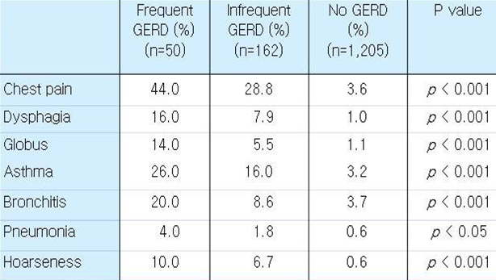
The frequency of Atypical Sx by frequency of GERD frequency of GERD : at least weekly GER Sx
Choi et al J Gastroenterol Hepatolgy 2001;16:A125

Slide 42
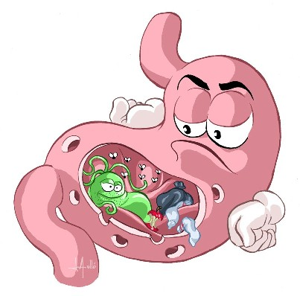
How frequent ?
In Korean GERD patients
  hoarseness (55%), globus (45%)
  chronic cough (25%), non-cardiac chest pain (20%)
  J Gastrointest Motil 2000;6

Slide 43
Extraesophageal manifestations
ENT | Pulmonary | Cardiac | Others
• Hoarseness • Globus • Laryngitis • Sinusitis • Otitis • Vocal granuloma • Vocal polyp • Subglottic stenosis • Laryngeal ca. | • Chronic cough • Asthma • Aspiration Pn • Bronchiectasis • IPF | • Chest pain • Sinus arrhythmia | • Dental erosion • Halitosis • Sleep apnea

Slide 44
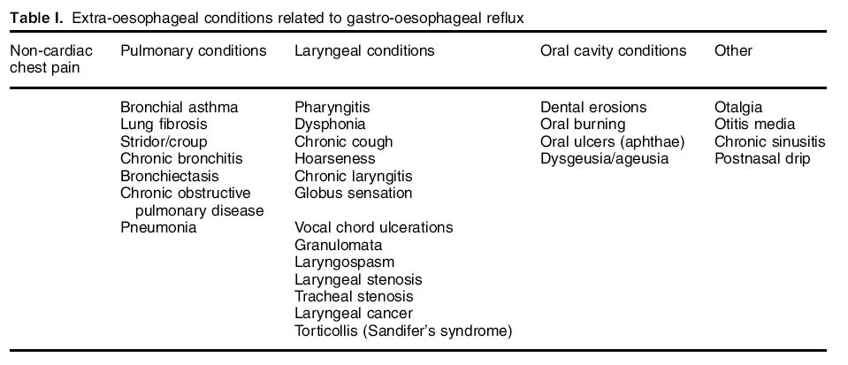

Slide 45
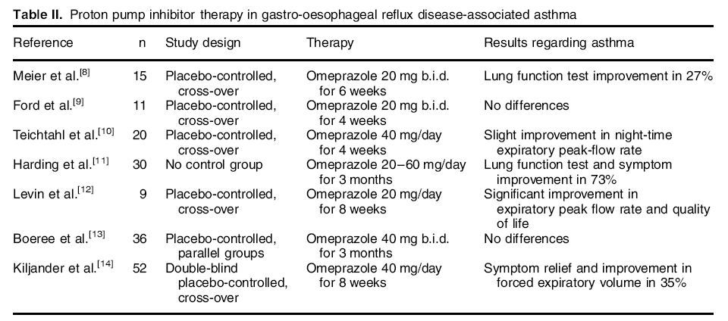

Slide 46

Chest pain
Typical angina
  1) Retrosternal discomfort
  as pressure / heaviness for several minutes
  2) Induced by exertion, emotion, cold exposure, large meal
  3) Relived by rest or nitroglycerin
Atypical angina
  Any two of the above findings
NCCP
  One or none of the above things

Slide 47
NCCP
Abnormal esophageal acid exposure has been recorded in up to 60% of the patients presented with NCCP.
Approximately 80% of the NCCP patients with either abnormal upper endoscopy or pH testing responded to potent antireflux treatment
J Gastroenterol Hepatol 2004;19

Slide 48
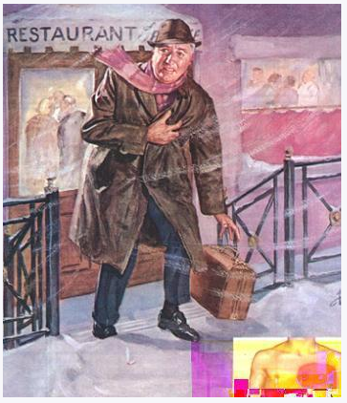
Linked Angina
Esophagocardiac reflex
  Esophagus and heart share similar sensory innervation
  Acidification of distal esophagus
  → reduction of coronary artery blood flow
  → associated with typical angina pain
Eur Heart J 1996;17
Circulation 2004;109

Slide 49
When coexist of Asthma & GERD
Begin later in life
Family history of asthma (-)
Absence of allergic symptoms
Onset of reflux before asthma
↑ Wheezing after meals
↑ Wheezing during sleeping
Aggravation by theophylline/B₂-agnonist
Difficult-to-treat asthma

Slide 50
ENT
Signs
  reflux laryngitis (=post. acid laryngitis)
  vocal cord nodules, edema, granuloma, contact ulcer
  arytenoid edema
  laryngeal carcinoma/stenosis
  laryngospasm
Symptoms
  hoarseness, globus sensation, throat clearing
  sore throat, voice change

Slide 51
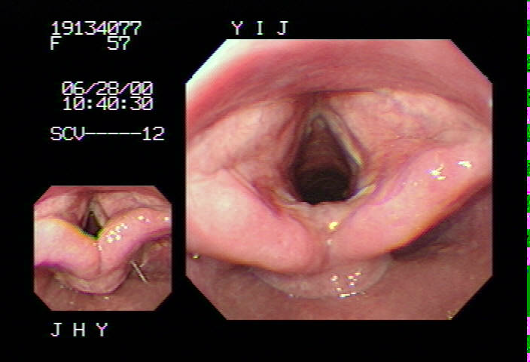
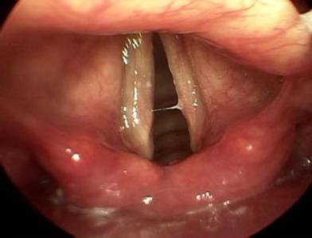
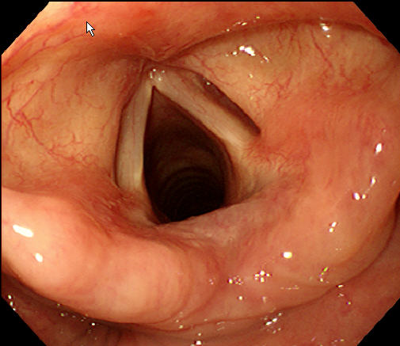
Specific signs for GERD-induced laryngeal injury
Vocal cord hyperemia
Arytenoid medial wall erythema
Post. Cricoid wall erythema
Arytenoid medial wall erythema

Slide 52
LPRD 환자의 Chief Complaint
1. Globus Pharyngeus 2. Cough 3. Throat Clearing
N=82 (무응답 4명)
83%
79%

Slide 53
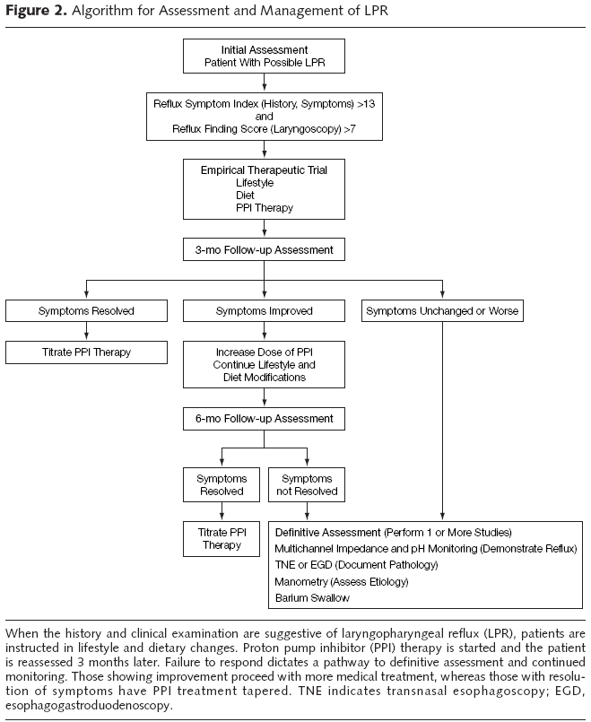
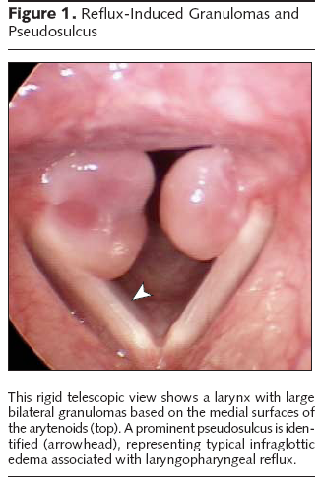

Slide 54
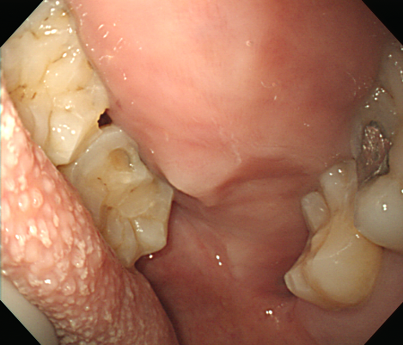
Dental erosion
Mandibular molars
– TMC sites
Maxillary lingual surface
  most severely affected site
  Dig Liver Dis 2003;35

Slide 55
후두 내시경 검사 후 다음의 소견 3가지가
발견되면 보험청구가능

Slide 56
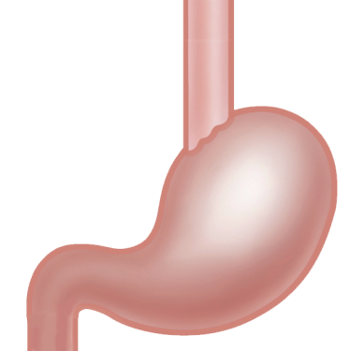
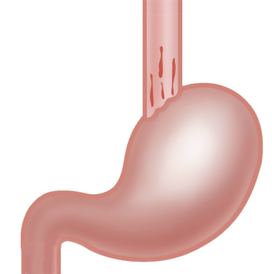
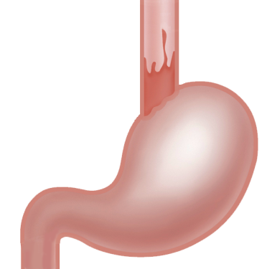
GERD는 3개의 별개 질환으로
구성 공통점은 Symptom
GERD : 각각 3개의 서로 다른 질환으로 구성¹
Stricture,
Barrett’s
Esophagus
Erosive
Esophagitis
NERD
Little*
None
Atypical symptom
Extraesophageal manifestation
Stricture
Ulcer
Bleeding
Adenocarcinoma
공통점 : a patient-centered (symptom) approach
that is independent of endoscopic findings²
1. Fass R, Ofman J. Am J Gastroenterol. 2002;97:1901-1909.
2. Vakil et al. Am J Gastroenterol 2006;101:1900-1920
Notes:
.

Slide 57
증상 (Heartburn)의 심한 정도 : 차이 없음
Erosive Esophagitis
NERD
Mild
Mild
Moderate
Moderate
Severe
Severe
Heartburn 증상의 지속 기간 (duration)에 있어서도 두 군간 차이는 없음. N = 1,532
Carlsson R et al. Eur J Gastroenterol Hepatol. 1998;10:119-124.
Smout AJ et al. Scand J Gastroenterol. 1996;218:10-15.
Venables TL et al. Scand J Gastroenterol. 1997;32:965-973.

Slide 58
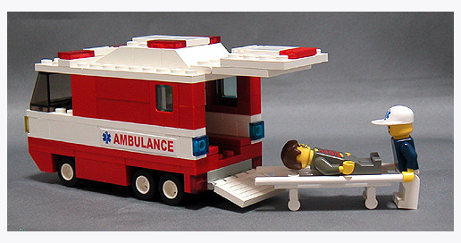
Alarm Symptoms
Weight loss
Anemia
Hematemesis
Melena
Family Hx of gastric and/or Eso. cancer
NSAID
Progressive dysphagia
Age>40 years in areas with
high prevalence
of gastric cancer

Slide 59
GERD 진단 : PPI Test
(Empirical Therapy)

Slide 60
GERD 진단 : PPI Test (Empirical Therapy)
Heartburn
score
Pariet
20
OME
20
LAN
30
1
2
3
4
5
6
7
Days
Sakai J et al Gastroenterology 2002: abstract

Slide 61
Empiric Therapy for GERD
PPI Test
1. GERD 증상인 경우 : standard dose PPI 2주
2. Extra-esophageal/atypical Sx인 경우
twice-daily half dose 2주
Sensitivity 78-90%
Specificity 60-80%
If effective → 추가 4주 치료 → on demand
If ineffective → further diagnostic testing

Slide 62
Empirical Therapy
Early Endoscopy
OR
Decrease patient’s
discomfort
Decrease invasive test
Significant cost savings
Alarm features
Atypical symptoms
Refractory to initial Tx
Preoperative assessment
Reassurance

Slide 63
Los Angeles classification (1999)
Grade A
Mucosal breaks confined to the mucosal fold, each no longer than 5 mm.
Grade B
At least one mucosal break longer than
5 mm confined to the mucosal fold but
not continuous between two folds.
Grade C
Mucosal breaks that are continuous
between the tops of mucosal folds
but not circumferential.
Grade D
Extensive mucosal breaks engaging at
least 75% of the esophageal
circumference.
Notes:
이는 mucosal break의 크기를 기준으로 한것으로 한것으로, 이는 임상 증상의 정도및 24시간 산도검사상의 병적인 역류, 치료에 대한 반응정도등이 mucosal break 의 범위와 잘 일치한다.

Slide 64
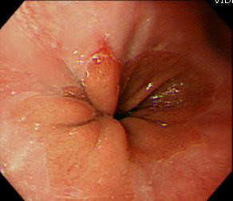
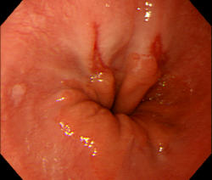
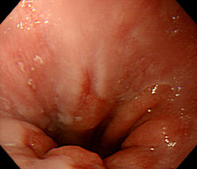
LA Classification, Grade A
One or more mucosal breaks confined to the mucosal folds, each no longer than 5mm

Slide 65
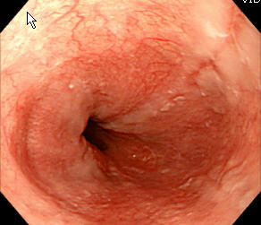
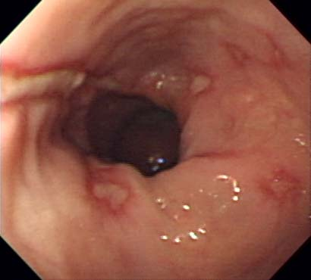
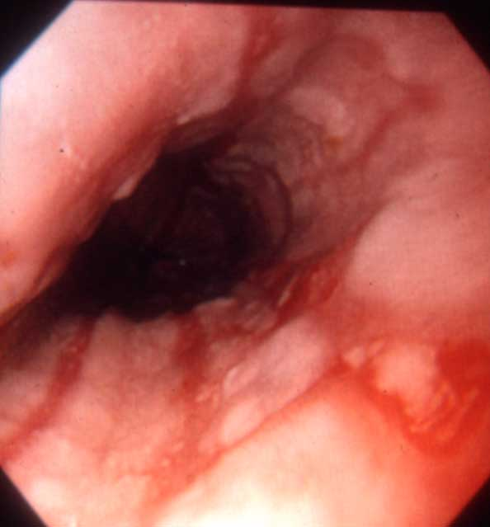
LA Classification, Grade B
One or more mucosal break more than 5mm long, that does not extend between the tops of two mucosal folds

Slide 66
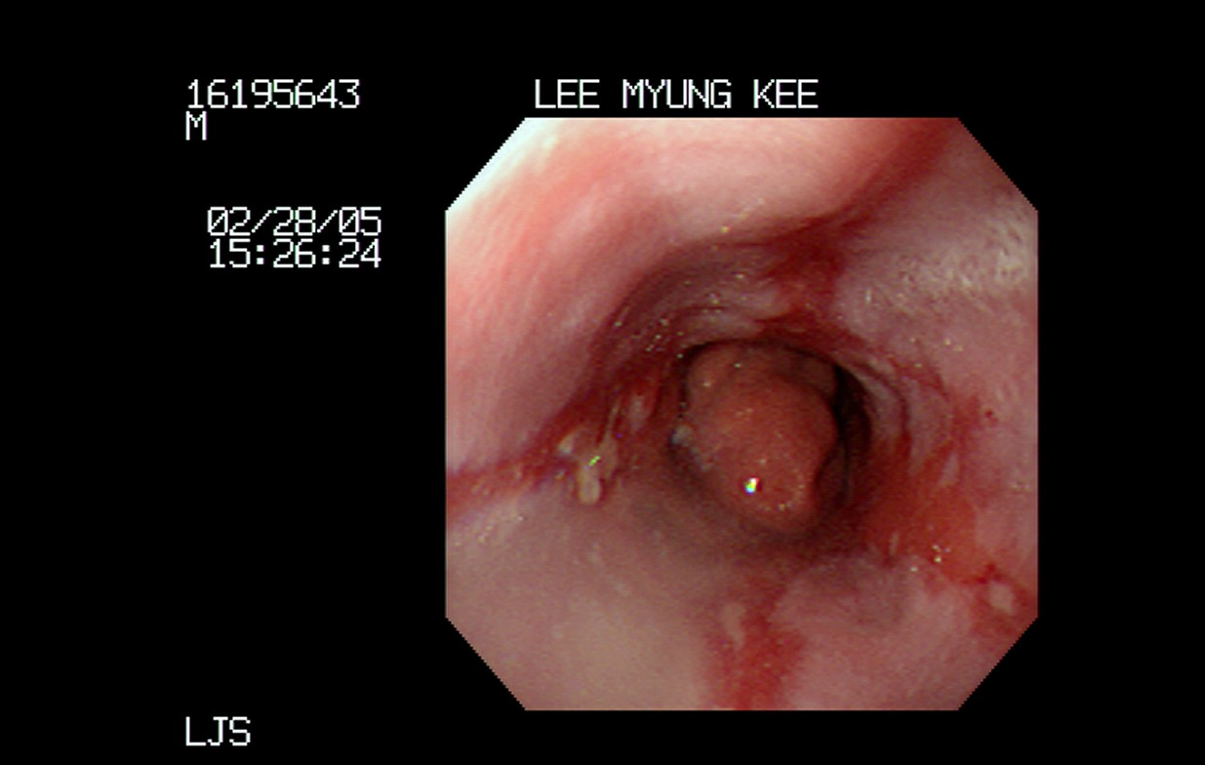
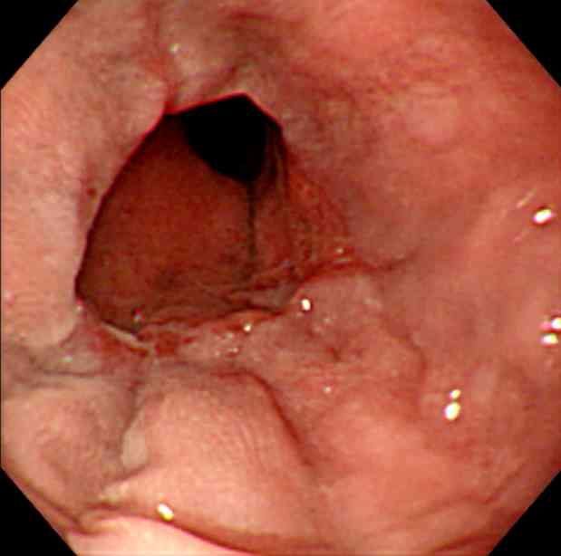
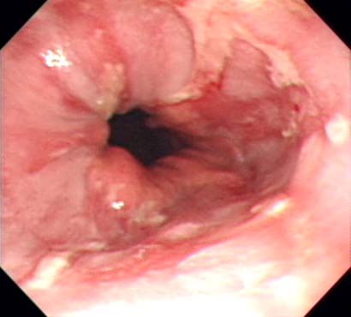
LA Classification, Grade C
One or more mucosal break that is continuous between the tops of two or more mucosal folds but which involves less than 75% of the circumference

Slide 67
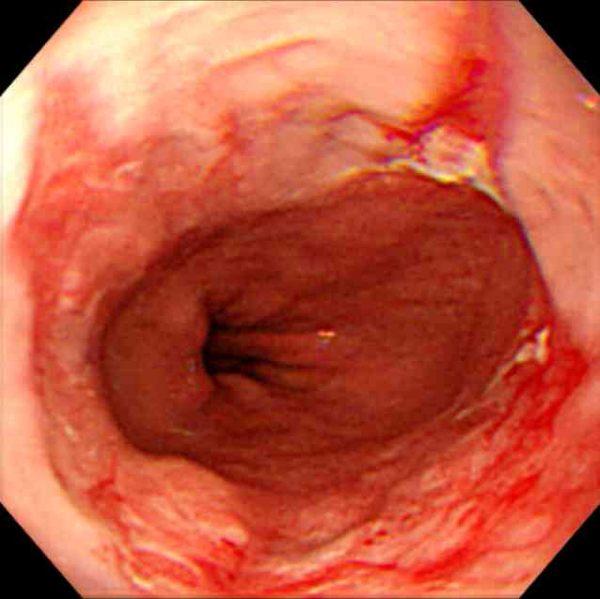
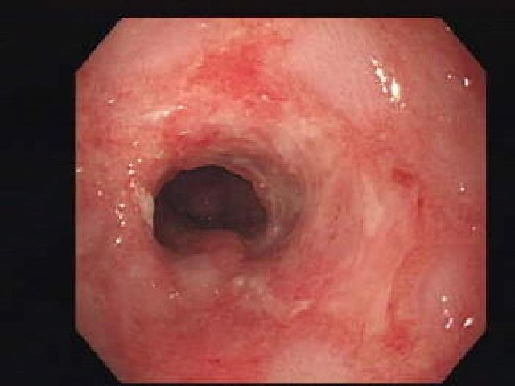
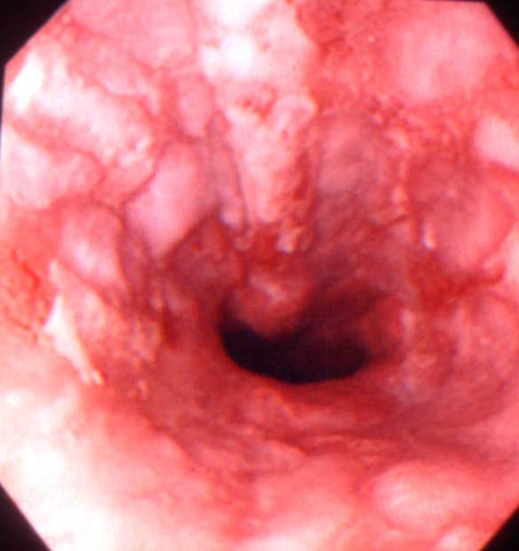
LA Classification, Grade D
One or more mucosal break which involves at least 75% of the esophageal circumference

Slide 68
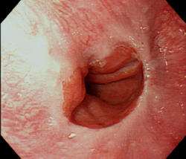
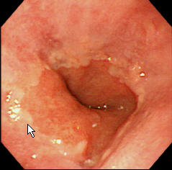
Minimal Change : Blurring

Slide 69
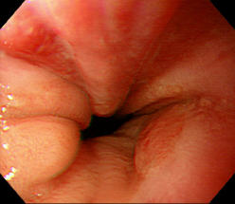
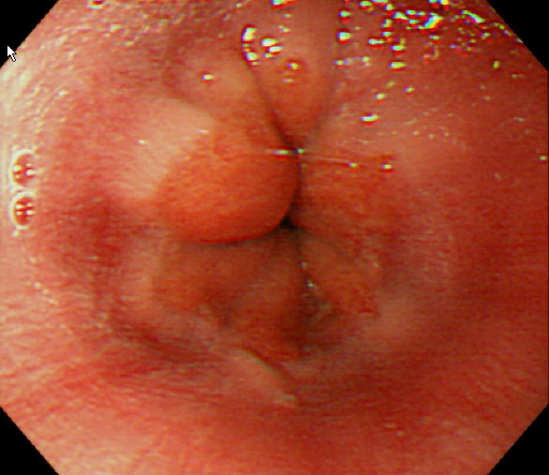
Minimal Change : Erythema
Capillary dilatation & proliferation
Elongation of papillae

Slide 70
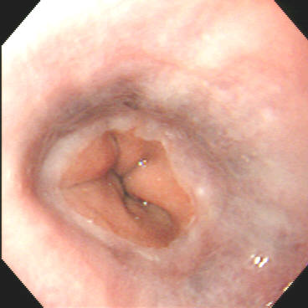
Minimal Change : Hyperemia

Slide 71
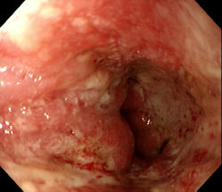
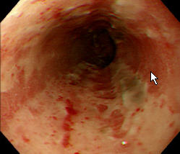
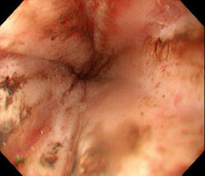
Minimal Change : Friability
Duodenal ulcer with obstruction

Slide 72
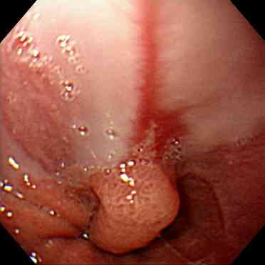
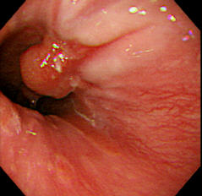

Minimal change, sentinel fold
(edema/accentuation of mucosal fold)
With mucosal break

Slide 73


Barrett’s esophagus
Extensive columnar metaplasia (1975)
Endoscopic with histologic BE
(intestinal metaplasia)
Gastro-esophageal junction
: Endoscopic marker
- proximal margin of gastric folds
- distal ending of longitudinal
vessels

Slide 74

GERD = Chronic Disease
3개월 후 55~80% 재발
6개월 후 75~90% 재발
Carlsson R et al. Eur J Gastroenterol Hepatol. 1998;10:119-24

Slide 75
Tx
medical

Slide 76

Medical Tx of GERD

Slide 77

H2RB
위벽세포의 히스타민-2 수용체에 작용하여 위산분비 억제
표준용량에서 위산억제효과는 거의 동일
경증의 GERD에서 좋은 초기증상 치료제로 생각되었으나
최근에는 PPI로 대체되는 경향
투여의 가장 효과적인 시간은 저녁식사와 취침전 중간

Slide 78
Potency of H2 receptor blockers
Famotidine 7.5 times > Ranitidine (잔탁, 큐란)
Famotidine (가스터) 20 times > Cimetidine
Lafutidine (스토가) ≥ Nizatidine ≥ Famotidine

Slide 79

H2RA 한계 : Tolerance
H2RAs는 투여 1-2주 이내에 위산분비억제능에 tolerance가 생겨 장기치료에 비효과적
Wilder-Smith, 1992, Scand. J. Gastroenterol

Slide 80

NSAID 위장장애를 masking하여
더 심각한 결과를 초래할 수도
Notes:
앞서 말씀 드린 내성 등의 문제로, H2RA는 NSAID로 인한 위장장애의 예방제로 추천되지 않습니다.
오히려, 평소에 증상을 masking 하여 입원율을 높이는 등 상황을 더 악화시킬 수 있습니다.

Slide 81

PPI

Slide 82

PPI ; problem

Slide 83
PPI Half/Full dose
구분 | 질환명 | 품목 | 상세 허가적응증 | 용량
위식도 역류질환의 장기 유지요법 | GERD Maintenance | 파리 에트 | 위식도역류질환의 장기간 유지요법 | 10 mg 20 mg
 |  | 란스톤 | 미란성 식도염의 치료후 유지요법 | 15 mg 30 mg
 |  | 넥시움 | 식도염환자의 재발방지위한 장기간 유지요법 | 20 mg 40 mg
 |  | 판토록 | 역류성 식도염 재발방지를 위한 장기유지요법 | 20 mg 40 mg

Slide 84
Prokinetics
1st Generation
  Central & peripheral dopamine-2,3,4 antagonists
  e.g. levosulpiride (1964,1979)
2nd Generation
  Central & peripheral dopamine-2 antagonists
  e.g. metoclopramide(1962), clebopride(1975)
3rd Generation
  Peripheral Dopamine-2 antagonists
  e.g. domperidone(1978)(모티리움 M), itopride(1995)(가나톤)
4th Generation
  5HT₄ agonist, 5HT₃ antagonists
  e.g. Mosapride(가스모틴)

Slide 85
CNS S/E
Levosulpiride
  sleep disturbances
  agitation
  Extrapyramidal effects (as frequent as chloropromazine)
  Female? (galactorrhea, anxiety)
Domperidone, Itopride, Mosapride
  Does not cross BBB

Slide 86
Antidepressants
Increasingly used in FD
Mechanisms
  unclear
  independent of psychiatric effects
Low dose of tricyclic antidepressants
  nortriptyline / desipramine
  10-25 mg/day → 50-75 mg/day
  side effects : common
Serotonin reuptake inhibitors
  cause nausea & dyspepsia
  uncommonly used

Slide 87

Refractory
GERD

Slide 88
위식도 역류질환에 도움되는 습관
식후 2-3시간 이내에는 바로 눕지 마세요.
취침 3시간 전에는 음식물을 드시지 마세요.
취침시 베개를 높여 주세요. - 좌측와위
식도괄약근의 힘을 약하게 하는 음식이나 음료를 삼가세요.
  초코렛, 술, 커피, 탄산음료, 박하류 등 고지방식을 줄이고 과식을 피하세요.
담배는 금하시는 것이 좋습니다.
  흡연은 하부 식도괄약근의 운동을 방해합니다.
몸을 조이는 내의나 옷의 착용을 피하세요.
비만이신 경우, 체중을 줄이는 것이 도움이 됩니다.
Notes:
88

Slide 89
Antisecretory | Coating agent | Prokinetics | Antacid | Antispamodic
PPI
파리에트 란스톤 판토록 판토라인 넥시움 | 가스트렉스 가스론엔 뮤코스타 스티렌 셀벡스 얼서민 | 가나톤 가스모틴 모티리움엠 레보설피리드 맥페란 | 듀란타 듀라겔 알마겔 | 포리부틴 티로파 스파몬 알기론
Acid PI
레바넥스 | 라미나지액
H2RB
잔탁 가스터 스토가 알비스

Slide 90


Slide 91


Slide 92


Slide 93
If GERD Sx
  full dose PPI qd + Prokinetics tid
  불응시
    PPI 투여 시간 변경
    다른 PPI로 혹은 다른 prokinetics로 교체 고려
    add TCA half dose qd hs
Charting : 속이 쓰리다
Code
  K219 : NERD
  K210 : GERD

Slide 94

Constipation

Slide 95
유병률 : 16.5%
정의
  의사 : 주로 횟수를 강조하여 배변이 3-4일에 한번 미만인 경우
  일반인 : 배변 시 과도하게 힘주는 경우로 생각하는 것이 52%, 단단한 변 44%, 배출장애 34%, 배변의 횟수가 적은 경우 32%, 불완전 배변 19%, 그리고 화장실에 머무는 시간이 긴 경우 11% 등

Slide 96
변비를 호소하는 환자는 1차 의료기관의 경우 7%, 3차 의료기관의 경우 4%를 차지하는 데 불과하다.
  변비환자들이 의료기관을 찾지 않는 이유는 경미한 증상이 많고, 식품이나 차와 같은 민간요법에도 완화될 수 있기 때문이다.
  최근 들어 대장암이 증가함에 따라 변비에 대한 일반인의 관심도 증가하고 있고, 의료기관을 찾는 변비 환자가 늘어나고 있다.

Slide 97
미국의 경우 변비 치료를 위해 연간 8억 달러.
변비 치료의 목적은 배변 횟수를 줄이고, 변비에 따른 제반 수반 증상인 힘주기, 고창, 단단한 변, 잔변감 혹은 복통, 복부 불편감을 해소 하는 것

Slide 98
Functional Constipation : ROME III Diagnostic Criteria
  1. Must include 2 or more of the following
    a. Straining during at least 25% of defecations
    b. Lumpy or hard stools in at least 25% of defecations
    c. Sensation of incomplete evacuation for at least 25% of defecations
    d. Sensation of anorectal obstruction/blockage for at least 25% of defecvations
    e. Manual maneuvers to facilitate at least 25% of defecations (eg, digital evacuation, support of the pelvic floor)
    f. Fewer than 3 defecations per weeks
  2. Loose stools or rarely present without the use of laxatives
  3. There are insufficient criteria for IBS
Criteria fulfilled for the last 3 months with symptom onset at least 6 months prior to diagnosis.

Slide 99
Classification
1. Constipation due to low intake
2. IBS (irritable bowel syndrome) with constipation: pain, bloating, and incomplete defecation predominate
3. STC (slow transit constipation) : pelvic floor function appears to be normal, and there is evidence of slow transit
4. Rectal outlet obstruction (anismus/dyssynergia-failure of relaxation: or descending perineal syndrome and other flaccid disorders)
5. Combination of 3 and 4, often in conjunction with the feature of IBS
6. Organic constipation (mechanical obstruction or drug side effect)
7. Secondary constipation (metabolic disorders)

Slide 100
C-IBS
Slow Transit
Pelvic Floor
Dyssynergia
Absent/Diminished desire to defecate

Slide 101

Exepted Low intake

Slide 102


Slide 103


Slide 104
진찰소견
회음부 관찰과 직장수지검사를 다음과 같은 요령으로 시행한다.
회음부 관찰
  먼저 환자를 왼쪽으로 눕게 하여 무릎을 구부려 가슴에 붙이게 한다. 엉덩이를 벌리고 환자에게 모의배변과 괄약근을 압축시켜(squeeze) 회음부의 하강/상승을 관찰한다.
  모의 배변할 때 회음부가 내려오지 않는 경우(정상적으로 1-3.5 cm 하강)는 골반저 근육의 이완부전을 의심한다.

Slide 105
직장 수지검사는 대변매복(fecal impaction), 협착, 직장 종괴를 진단할 수 있는 좋은 검사법이다.
  직장에 손가락을 넣은 상태에서 환자에게 항문괄약근을 압착하도록 하여 휴식 때와 비교하여 항문괄약근의 압력이 상승되는지를 느껴 본다.
  치골직장근을 만져보고 통증이 유발되는지를 살핀다.
  마지막으로 환자에게 직장에 넣고 있는 손가락을 배출하도록 하여 골반저의 움직임을 느껴 본다.

Slide 106
Alarm symptoms
≥45 years (new onset)
Recent bleeding or melena
Weight loss of >10% of body weight
Anorexia/early satiety
Persistent vomiting
Anemia or bleeding
Abdominal mass or lymphadenopathy
Progressive dysphagia or odynophagia
Family history of GI cancer
Previous gastric surgery or malignancy
Previous history of peptic ulcer
Jaundice
=> ≥ 30 years
The value of alarm symptoms is less clear in populations with a high incidence of gastroesophageal malignancy.

Slide 107
변비환자에 대한 대장 내시경검사에서 대장암과 선종의 발견율은 각각 2.0%와 19.3%이며 S상 결장검사는 각각 1.0%, 5.9%로 보고.

Slide 108


Slide 109


Colon transit time : 4 or 7days?

Slide 110
단일 표지자법
캡슐 하나(20-25개의 방사선 비투과 물질 포함)를 복용 후 5일째 단순복부 촬영을 하여 표지자가 20% 미만으로 남은 경우를 정상으로.

Slide 111
다수 표지자법
다수 표지자법은 캡슐을 하루 한 개씩 일정한 시간에 3일간 복용한다. 첫 투약 후 4일째(마지막 캡슐 복용 후 24시간) 동일한 시간에 앙와위에서 복부 방사선 촬영을 시행한다. 4일째 촬영에서 방사선 표지자가 남아있는 경우 3일 간격으로(7일째, 10일째, 13일째 등) 표지자가 모두 배출될 때까지 단순복부 촬영을 반복한다.
임상에서는 4일째 사진만으로도 서행성 변비(slow transit constipation)의 감별에 충분하다.

Slide 112
우측 대장에 방사선 비투과 표지자가 오랫동안 남아 있으면 대장운동의 저하(colonic inertia)로 진단할 수 있으며, S상 결장과 직장에 방사선 비투과 표지자가 많이 남아 있으면 배변기능의 이상을 추정할 수 있다.
과민성 대장증후군에 의한 변비는 정상 대장통과 시간을 보이는 경우가 많다.
그러나 변비 환자에서 대한대장통과시간 연구들을 보면 서행성 변비의 빈도는 38～80%로 다양.

Slide 113

SmartPill

Slide 114
최근 캡슐내시경이 발전하면서 단순히 내시경의 역할 뿐만이 아니라 위장관의 압력과 pH를 측정할 수 있는 캡슐내시경(SmartPill)이 개발되었다.
일반적인 비투과성 표지자와 SmartPill을 함께 검사하여 방사선 비투과성 표지자에 비하여 위, 소장, 대장의 분절 통과시간을 더 자세히 확인할 수

Slide 115
직장 항문 내압 검사
모의배변 시도에서 복압이 50 mmHg 이상 올라갔음에도 항문 괄약근의 역행적 수축 혹은 항문 괄약근압의 이완이 20% 미만일 때로 정의.
한 연구에서는 PFD가 배변 협동장애가 내압검사로 63%, 근전도38%, 배변조영술로 36%가 진단되어 검사법마다 진단의 민감도가 다름을 시사해주고 있다. 향후 이들 직장항문검사법에 대한 표준화와 임상적 유용성에 대한 검정작업이 요구된다.

Slide 116
풍선 배출 검사
풍선배출검사는 검사실 환경에서 환자가 변을 배출할 수 있는지를 평가하는 검사이다.
방법은 단순하여 가는 관에 풍선을 매달아 50 cc의 물을 채워 환자의 직장에 넣은 후 좌변기에 앉혀 환자로 하여금 배출하게 한다.
  대한소화관운동학회에서는 3분 내에 풍선을 배출시키지 못하는 것을 양성으로 판정.
민감도는 88%, 특이도 89%, 양성예측률 67%, 음성 예측율 97%로 보고하여 풍선배출검사 정상이면 배변 협동장애를 배제할 수 있을 것을 시사하였다.

Slide 117

배변 조영술
검사용 조영제 250 cc를 관장용 주사기로항문을 통해 배변감을 느낄 때까지 주입하고 특수 변기에 앉혀 투시로 확인하고, 비디오 녹화를 하면서 안정시, 항문수축시 및 배변시 촬영을 하는 검사법
배변조영술의 소견은 환자와정상인 간에 중복이 되고 조영술 소견과 증상의 연관성이 낮으며 검사기관이나 검사자 간의 진단의 일치율이 낮다는 단점
  배변기능이상을 평가하는 단독검사법으로 신뢰할 수 없고 직장항문 기능의 임상과 내압검사의 평가에 보조적인 진단

Slide 118



Defecography

Slide 119

dynamic MR defecography
배변조영술은 방사선에 노출되는 단점 이외에 환자가 검사자 앞에서 배변을 하게 되기 때문에 긴장을 하여 위양성이 나올 수 있는 가능성이 있다. 또한 측정 소견이 환자와 정상인 간에 중복이 많다는 보고도 있다.

Slide 120
C-IBS
Slow Transit
Pelvic Floor
Dyssynergia
Absent/Diminished desire to defecate
Notes:
Recently in this field, new concept of chronic constipation is emerging.
Rectal hyposensitivity is known to exist in somewhere between classical constipation subgroups such as slow transit and pelvic floor dyssynergia.
It has diverge spectrum of clinical manifestations from chronic constipation and fecal incontinence, and so on, but most common presentations are known as chronic constipation

Slide 121


Slide 122


Constipation
Slow transit constipation
  Colonic inertia(장무력증)
Defecation disorder
  Pelvic floor dysfunction (PFD)

Slide 123
로마 기준에서는 과민성 장증후군은 제외되므로, 엄밀한 의미의 만성 기능성 변비 환자는 골반저 근실조와 서행성 변비 환자가 주를 이룬다고 할 수 있다.
그런데 이 두 질환은 그 치료가 확실히 달라서,
  골반저 근실조는 바이오 피드백 치료로 효과적으로 치료되는 것으로 알려져 있으나,
  서행성 변비는 바이오 피드백 치료에 효과가 적으며 어떤 치료에도 반응하지 않는 심한 환자의 경우에는 수술적 치료를 고려하여야 한다.

Slide 124
직장수지검사에서 손가락을 직장 안에 넣은 후 힘주기를 하게했을 때 항문관(anal canal)의 압력이 떨어진다면 골반저 조율장애를 배제할 수 있다.
  그러나 직장수지검사로 항문관압이 상승된다고 하여 골반저 조율장애라고 진단할 수는 없다.
  골반저 조율장애는 증상만으로 진단하는 것은 부적절하며, 반드시 내압검사나 근전도를 시행하여 역설적 수축 뿐 아니라 불완전 배출과 검사 시에 적절한 추진력이 가해졌다는 증거가 같이 있어야만 진단할 수 있다.

Slide 125

서행성 변비 환자군에서 골반저 근실조 환자군보다 단단한 대변을 호소하는 빈도가 높았으며(p<0.05), 주당 3회 미만의 배변 횟수를 호소하는 빈도도 유의하게 더 높았다(p<0.05).
골반저 근실조와 연관되었다고 알려진 배변시 과도한 힘주기, 잔변감 및 배변을 돕기 위한 수조작의 증상들의 발현 빈도 및 분포를 비교하였을 때 세가지 증상 모두를 가지는 경우 및 두가지 증상을 함께 가지는 경우를 골반저 근실조군과 서행성 변비간에 비교하였을 때 유의한 차이가 없었고, 일인의 검사자에 의한 직장수지검사상의 항문 괄약근 역행적 수축의 비율도 두 군 사이에 차이가 없었다.

Slide 126
기능성 변비 환자 중 바이오 피드백 치료로 좋은 치료효과를 기대할 수 있는 골반저 근실조는 임상 증상이나 직장수지 검사만으로는 다른 형태의 변비환자들로부터 구별해 낼 수가 없었다.
  따라서 환자의 병태 생리를 파악하기 위한 대장통과시간 및 항문직장 기능검사가 변비 환자의 치료 방침 결정을 위해 꼭 필요할 것으로 사료된다.

Slide 127
Tx.
Bio feed back
EST

Slide 128
Bio feed back therapy
Mechanism
  Learning through Reinforcement
Indication
  Pelvic floor dysfunction
  Fecal Incontinence
  Anorectal pain
  Intussusception

Slide 129



Manometry based
EMG based

Slide 130
Bio Feed Back의 문제점
치료 효과 : 60-70%
환자의 요소
  치료 의지, 교육정도, 나이
  Pathophysiology의 차이
  신경과적 문제가 있는 환자는 어렵다.
치료자의 요소
  치료자마다 방법이 다름.
  치료자와 환자의 rapport 형성에 따라 효과 다름.

Slide 131
Novel Treatments for PFD
Electrical Stimulation Therapy
Botulinum Toxin Injection
Rectal Pacing
Puborectalis manipulation

Slide 132
C-IBS
Slow Transit
Rectal
Hyposensitivity
Pelvic Floor
Dyssynergia
Absent/Diminished desire to defecate

Slide 133
History of Electrical Stimulation
1952 Bors Urinary Incontinence
  EST in pudendal nerve
1963 Caldwell pelvic floor implanted electrodes
Current Use
  Rehabilitation Medicine
    Pain management
    Sensory recovery
  Urology and Gynecology
    Urinary Incontinence
  Gastroenteorlogy
    Anal Incontinence
    Constipation?

Slide 134



Electrical Stimulation Therapy (EST) in Urogenital Diseases
Effective treatment for stress incontinence & urge incontinence
Mechanisms
  Urethral Sphincter reinforcement
  Stimulate Levator Ani Muscle
  Relaxation of Muscles with repetative stimulation
  External Anal Sphincter?
  Puborectalis Muscle?
Pelvic Floor Disorders 1st edi. 2004

Slide 135


Indication of EST
Constipation – Hyposensitivity, Tenesmus
IBS
Fecal incontinence
Anal pain

Slide 136
Contra - indication
Heart problem - Heart pacemakers
Pregnancy, if the risk of pregnancy exists
Bleeding - menstruation
Probe 삽입 불가능한 경우 - Anal stricture
CFS - Tumor, Ulcer, Colitis, Obstruction
Prostatitis

Slide 137
C-IBS
Slow Transit
Rectal
Hyposensitivity
Pelvic Floor
Dyssynergia
Absent/Diminished desire to defecate

Slide 138
  Autonomic & Somatic innervations
  of the colon & Anorectal area
Upper GI
Vagus nerve
: sympathetic fiber
: parasympathetic fiber
Spinal cord
Sympathetic
chain
.
.
SMG
T10
T11
T12
L1
L2
.
IMG
.
PG
S2
S3
S4
EAS
Pudendal nerve
Notes:
직장 항문에 관여하는 자율 신경게를 살펴보면 pudendal nerve는 주로 s 234 가 관여함을 알수가 있습니다

Slide 139

EST for slow transit constipation
배변만족도, 잔변감, 힘주기, 항문폐쇄감등의 증상도 모두 통계적으로 유의하게 호전.
전체 대장 통과 시간과 직장 S상 결장부위 대장통과시간이 전기자극 치료 후 통계적으로 의미있게 감소.
  우측 및 좌측 결장은 전기자극치료 전후로 통계적인 차이를 보이지 않았지만 우측 대장통과시간은 감소하는 경향.
Song HK, Myung SJ, et al. Korean J Neurogastroenterol Motil 2003;9:134-141
Notes:
.

Slide 140

치료전에 변비 증상, 대변형태, 항문직장내압검사를 실시하였고, 3주간의 헛치료와 3주간의 S2-S3 피부분절에 대한 자기장 치료를 무작위 교차방식으로 시행하였다.
변비 증상, 대변형태, 항문직장내압검사를 3주째와 6주째에 반복 측정하였다.
자기장 자극 기간 동안에 14명 중 8명에서 자발적 배변 횟수의 증가가 관찰

Slide 141
우측보다는 좌측 결장에서의 지연이 있는 환자에서 호전이 있었는데 이는 두번째와 세번째의 천골 신경에서 기원하는 부교감신경을 통한 직장-S상 결장의 운동의 증가에 기인하였을 것으로 추정된다.
최근에는 덜 침습적인 방법으로 천골 신경 자극이 시도되어 난치성 서행형 변비에 효과적이라는 보고가 있었다.
  체신경계의 자극이 척수에서 자율신경반사를 조절하는 역할을할 수 있음이 보고되어 있다.
  천골 피부분절을 전기적으로 자극한 경우에 직장-S상 결장 부위의 운동이 증가함이 또한 보고되어 있다.

Slide 142
Complication of EST
Anal bleeding
Dizziness
Fatigue
Anal pain
Jung KW, Myung SJ, et al. Gut and Liver 2008

Slide 143
배변 습관과 생활 양식의 변화
가장 적절한 시간은 식후 위-대장 반사를 이용하기 위하여 아침 식사 후나 저녁 식사 후 또는 걷고난 후이므로 이러한 시간에 변기에 앉는 것이 좋다.
  장운동의 최적 시간은 걷고 난 후 2시간 이내나 아침 식사 후
10분 이상 오랜 시간 변기에 앉아 있지 않는 것이 중요하며 고관절을 구부려 쪼그리는 자세가 되도록 지도한다.

Slide 144
변의의 유무에 상관 없이 강박적으로 일정 변기에 앉아 힘주어 대변을 배출하려고 하나 적절한 배변이 이루어 지지 않아 치핵, 변실금과 같은 항문 직장 병변을 유발할 수 있다. 이러한 경우에는 변의를 느끼는 경우에만 배변하도록 교육한다.

Slide 145

섬유소와 물의 섭취
성인의 경우 적어도 하루 20-35g의 섬유소와 1.5-2 L의 물을 섭취
  고섬유소 식이의 경우 초기에는 복부 팽만감 및 불편감, 부글거림이 발생할 수
식이 섬유의 경우 1주당 평균 1.4회의 배변회수를 증가

Slide 146
일반적으로 기저 질환을 동반하지 않은 정상인의 경우에는 섬유 식이 섭취가 대변 양을 증가시키는 것으로 알려져있다.
고섬유소 식이가 모든 변비 환자에게 도움이 되는 것은아니다.
  서행성 배출장애가 있는 경우나 골반저 기능이상이 있는 경우에는 고섬유소 식이에도 증상 개선이 뚜렷하지 않을 수 있다.

Slide 147
변비약
부피 형성 완하제
겨껍질, 한천, 차전자피(psyllium husk, 뮤타실),
아기오 과립, 실콘, 웰콘
점활성하제 (Emollient laxatives)
광유(mineral oil), 올리브유
삼투성하제 (Osmotic laxatives)
  Lactulose (듀파락), lactitol, 마그네슘제제 (마그밀)
자극성하제 (Stimulant laxatives)
  cascara, senna, aloe, 비사코딜 (둘코락스), 아락실( 차전자+senna), 동규자차
장운동촉진제
  가스모틴, 가나톤, 레보설피리드

Slide 148




부피 형성 완하제
식이 섬유 섭취가 충분하지 못한 환자에게 유용
일부에서는 장내 세균에 의해 대사되어 이산화탄소나 수소와 같은 가스를 형성한다. 이로 인해 복부 팽만감이나 다량의 방귀를 유발한다.
아기오 과립, 실콘, 웰콘

Slide 149


Slide 150
부피형성 완하제는 식전이나 취침 전에 복용하는 것이 좋고 장협착이나 장폐쇄 환자에서는 증상을 악화시킬 수 있으므로 사용해서는 안된다.
국내에 시판되고 있는 부피형성 완하제 중 일부는 센나(senna, 차풀, 석결명)와 같은 자극성 하제와 합성된 종류가 있으므로 이러한 경우에는 장기 복용을 피하는 것이 좋다.

Slide 151
삼투성 완하제
삼투성의 활성 이온이나 분자로서 장관에서 흡수되지 않고 장관내 수분을 이동시켜 배변을 용이하게 한다.

Slide 152


Slide 153
락툴로우스는 갈락토스(galactose)와 프록토스(fructose)의 합성 이당체로 혈중으로 흡수되지 않아 전신 순환에 위험이 없고 당뇨 환자의 혈당에 영향을 미치지 않아 당뇨 환자의 변비에도 투약할 수 있다.
  성인에서 권장되는 용량은 시럽 15 mL 씩 1일 2회 투여
  대장 세균은 하루 80g의 락툴로우스를 대사시킬 수 있으므로 실제적으로 이용량은 심한 만성 변비를 치료하는 데에는 부족하다. 따라서 경미한 변비를 치료하는데 유용하고 복용 후 2-3일 후에 효과가 나타나므로 이에 대해서 알려줄 필요가 있다.
  투여 초기에는 효과가 있으나 때때로 대장의 정상 세균총의 변화로 인해 효과를 상실하기도 한다.

Slide 154
락티톨은 갈락토스와 솔비톨의 이당류 유도체이다. 대장에서의 효과는 락툴로우스와 비슷하다. 또한 혈당에 영향을 주지 않기 때문에 당뇨환자에도 투여 가능하다.
솔비톨은 과당의 흡수를 억제하기 때문에 사과나 배와 같은 과일과 함께 복용할 경우 효과가 증가한다. 락툴로우스와 비교하여 변비 증상의 호전은 비슷하고 메스꺼움은 덜하다.

Slide 155
Mg
마그네슘 이온은 장에서 거의 흡수가 되지 않기 때문에 여러 가지 형태의 복합 제재로 만들어져 완하제로 사용 된다.
  작용 기전은 장에서 흡수가 되지 않고 삼투작용에 의해 완화 작용이 있으나 과량 복용 시 고마그네슘 혈증을 일으킬 수 있어 신기능 부전 환자와 소아에서는 주의하여 투여해야 한다.
  드물지만 어린이에게서는 혼수를 일으킨다.

Slide 156
마그네슘 복합 제재 중 황산 마그네슘이 다른 제재보다 더 강력하나 복부 팽만감, 갑작스런 액체 성분의 대변이 나오기 때문에 복용이 불편하다.
성인의 일반적인 권장량은 수산화마그네슘(마그밀) 2.4g 내지 4.8g이며 충분한 물과 함께 복용해야 한다.
  수산화 마그네슘과 부피형성 완하제를 비교하였을 때 배변 횟수가 증가하고 경도가 감소하였으며 추가적인 완하제가 필요하지 않다고 알려졌다.

Slide 157
Lactulose(듀파락)의 경우, PEG와 비교하였을 때 덜 유효하고 부작용이 더 많은 것으로 나타났고, psyllium과 비교하였을 때에는 효과에 차이가 없었다.

Slide 158

PEG
분자량이 큰 중합체로 장에서 흡수되지 않고 용액상태로 남아 그대로 배변이 되기 때문에 대장내의 삼투압의 증가로 인해 체내로의 수분 흡수를 방해하여 변이 부드러워지고 양도 증가하여 액상의 형태로 배설된다.
PEG는 위장관 세척용으로 주로 사용되나 외래에서 치료하는 노인의 난치성 변비 환자에 상당히 도움이 된다. PEG 용액에 적절한 전해질을 섞어주면 수분 중독이나 전해질 불균형 등을 해소할 수 있고 부작용은 1%에서만 나타난다.
상용화되어 있는 콜로나이트산(colonlyte)과 코리트산은 PEG와 전해질의 복합성분으로 되어있다. 하지만 최소한 2 L 이상을 한 번에 복용해야 하는 단점이 있다. 저용량 PEG 전해질 용액도 변비에 효과적인데 락툴로우스보다 효과적이다.

Slide 159

자극성 완하제

Slide 160
반드시 수주에서 길어도 수개월의 단기간만 사용한다.
안트라퀴논 제재는 널리 사용되는 동시에 남용되는 약제이다.
  작용은 복용 후 6-12시간 이내에 시작된다. 알로에(aloe), 카스카라(cascara), senna 등으로 식물에서 추출된다. 이는 대부분 비활성 배당체(glycoside)로서 소장에서 변화되지 않고 통과하여 대장에서 세균의 glycosidase에 의해활성 형태로 변한다. 따라서 상부 위장관에서는 효과가 나타나지 않는다.
  대장 상피세포의 사멸(apotosis)를 유도하여 사멸체(apoptotic body)를 형성한다. 이는 대식세포(macrophage)에 의해 포식되어 지방 갈색소양(lipofuscin-like) 색소를 형성하여 대장흑색종(melanosis coli) 소견으로 나타난다.
  대장흑색종은 근위부 대장에서 더 뚜렷하고 완하제를 중단하면 색소화된 대식세포가 림프절로 이동하여 사라지기 때문에 몇 개월 후에는 장점막이 정상화 된다.
  카스카라는 복통을 거의 유발하지 않는 약제이다.

Slide 161
페놀프탈레인이나 비사코딜(둘코락스)과 같은 폴리페놀제재는 장-간순환(enterohepatic circulation)을 하여 약효가 오래 지속되고 발진을 유발할 수 있기 때문에 사용하지 않는 것이 좋고 특히 담도 폐쇄환자들에서는 사용이 제한된다.
  비사코딜(둘코락스)도 대장상피세포의 사멸을 유도하나 색소침착은 생기지 않는다.

Slide 162
Colchine, Misoprostol
  배변 횟수를 증가시키고 복통, 팽만감 등을 개선시키고 대장통과 시간을 단축.
  임상에서는 잘 사용 안함.

Slide 163
Recent developments in the pharmacologic treatment of chronic constipation
Serotonergic enterokinetic agents
  Tegaserode
  Prucalopride
  Renzapride
Lubiprostone
Linaclotide
Peripheral Opioid antagonists
  Alvimopan
  Methylnaltrexone bromide
Neutrotrophins
Probiotics

Slide 164

Tegaserode
Zelmac, 젤막, Norvatis
65세 이상 여성, 12주
5-HT4 선택적인 부분 작용제
식후에는 생체 이용율이 40~65%까지 감소되므로 식전에 복용하는 것이 바람직하다.

Slide 165
Herbal supplements
No randomized controlled trials of the efficacy
Ginseng, Zanthoxylum Fruit, and Dried Ginger
  frequently used in Japan for the treatment of GI hypomotility
  stimulate intestinal peristalsis, which was associated with the resumption of regular bowel habits.

Slide 166


CHM interventions or CHM combined treatments showed benefit in the treatment of FC when compared with cisapride, PEG, mosapride, phenolphthalein, itopride and bifidobacterium alone.
the evidence and reliability of these conclusions are compromised by methodological flaws and lack of replicable validation.

Slide 167


Slide 168
식이 섬유가 많은 음식
곡류 – 보리 , 현미, 율무
해조류 – 미역, 다시마, 김, 한천, 톳
두류 – 콩, 팥, 완두콩, 청국장, 비지, 콩가루
채소류 – 배추, 무청, 시금치, 무말랭이, 상추, 우엉, 옥수수
당근, 고추, 고사리, 감자, 고구마, 토란, 연근
과일류 – 밀감, 수박, 배, 말린 무화과, 건포도
종실류 – 참깨, 땅콩, 호두

Slide 169

하루 식이섬유 권장량
백미밥 21 공기
보리밥 2.8공기
사과 9 개, 귤 18 개
배 5.5 개, 딸기 118알
양송이 15 접시, 오이 8-10개
배추 17 접시, 김치 10 접시
무우 16.2 접시
콩나물 16 접시, 김 39 장
미역 5.4 접시,양송이 15 접시

Slide 170



Slide 171

Melanosis coli

Slide 172
Prokinetics + Bulking agent
PEG
둘코락스/
아락실
Lactulose/Mg
듀라겔/디안타디오마/디오겔

Slide 173


